Slide 1
UCAS – What next?
Kevin Warren
15th February 2022
Empowering lives through learning

Slide 2
Offers/Rejections
Accommodation decisions
Student finance
What if I have no offers? UCAS Extra/Clearing

Slide 3
Offers and Rejections
You can use UCAS Track to track the five courses that you applied to.
You would have been given a link to this on the receipt email from UCAS – when they received your full application.
Any updates to your UCAS status will be explained in detail on Track, and you should monitor this daily.
….........................................................................................................................................

Slide 4
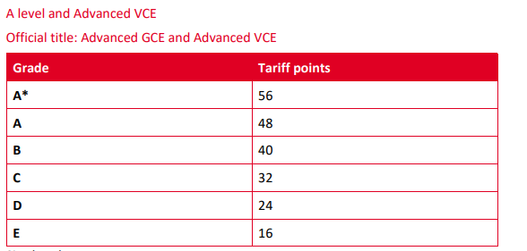
Conditional Offer - as the name suggests, your offer is subject to specific conditions. These will be specific grades that the university requires or a specific total point score (from the tariff points - guide opposite)
Unconditional – very unusual to receive one of these so do make sure to check the conditions of the unconditional offer. Often you can attend this university, regardless of your grades, but only if you choose them as your first choice. Please do read the small print. It is possible to have an unconditional as your insurance offer. You are then guaranteeing yourself a place at university.
Offers and Rejections
….........................................................................................................................................

Slide 5
Once you have heard from all five universities…
This is the time when you can choose your top two.
Your ‘firm choice’ and your ‘insurance choice’ are your top two universities. These are the universities that you are requesting to hold your place until results day. Make sure that ideally your insurance place has lower grades than your firm.
Please ensure that you make these two choices before the deadlines shown on UCAS Track (9th June for most courses) otherwise you will lose out on all of your offers.
….........................................................................................................................................

Slide 6
Choices
Firm choice – this is your first choice and should be the university that you would like to attend the most.
Insurance choice – this is your back-up. This needs to have a lower grade requirement than your firm choice, in case you do not achieve your predicted grades. You would still be happy to attend this option.
….........................................................................................................................................

Slide 7
Accommodation Decisions
Once you have confirmed your choice, accommodation information will be sent out sooner than you think. Always make sure you check your junk emails as information is often sent by an individual member of staff at a university, and may not be accepted into your inbox.
….........................................................................................................................................

Slide 8
Student Finance

Slide 9
Finance
It is up to you and your family to apply to student finance.
The main window for applications is March to May, so you will be able to start the process shortly. Please do not worry if you are asked to provide the name of the university you plan to attend.
If you have not as yet made your choices, this will not affect your application. You can use any university name here, but if you do know which one is likely to be your firm choice, then use it.
UCAS: Student Finance England
The main website for student financial advice, details and application information is via this link:
Student Finance Homepage
Quick Start Student Finance Guide
….........................................................................................................................................

Slide 10
Key Information TUITION FEE LOANS:
Tuition Fee Loans – £9,250 per year.
Paid directly to the university on your behalf
Key Information:
Fill in the application form online and provide evidence of identity.
How to apply: www.gov.uk/studentfinance
….........................................................................................................................................

Slide 11
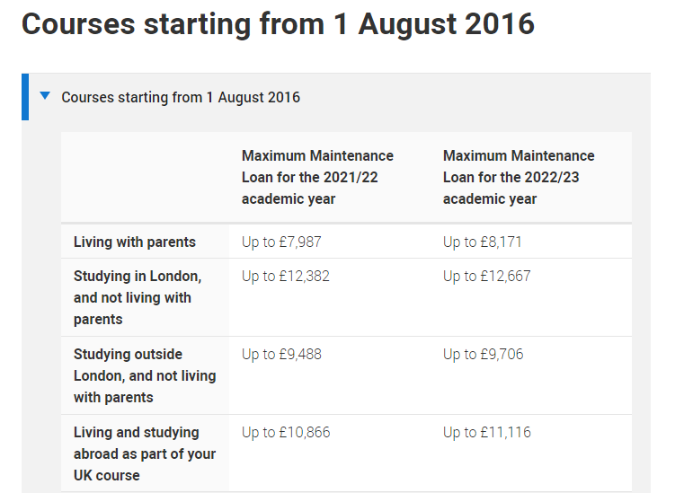
Key Information LIVING COSTS (MAINTENANCE) LOANS:
How much you can get depends on when you started your course, where you live, and your household income.
How to apply:
www.gov.uk/studentfinance
….........................................................................................................................................

Slide 12
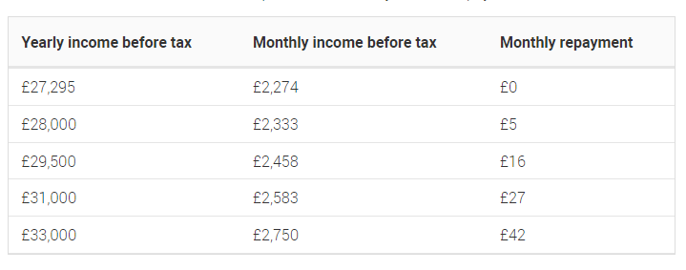
Repaying your loans
The important thing to remember is that the amount you’ll repay will be based on how much you earn, not how much you borrow.
Once you leave your course, you’ll only repay when your income is above the repayment threshold.
The current UK threshold is £27,295 a year, £2,274 a month, or £524 a week.
Example:
If you earn £27,720 (£2,310 a month before tax), you’ll repay £3 a month. This is because £2,310 is £36 above the monthly threshold of £2,274, and 9% of £36 is £3 (rounded down to the nearest pound).
….........................................................................................................................................

Slide 13
UCAS Extra and Clearing

Slide 14
What if I have no offers? (UCAS EXTRA)
If you receive no offers, you can still be considered through UCAS Extra. This service opens in February and UCAS will contact you to let you know you are eligible for Extra.
Find a course you want to apply for
Apply for the course through UCAS Extra
The university will consider your application. If you have not heard from them in 21 days, you can continue to wait or make an alternative choice through UCAS Extra.
If you receive an offer then subject to you meeting the conditions, you are in!
….........................................................................................................................................

Slide 15
What if my grades are lower than my firm and insurance choice university?
If this is the case for you, you can use clearing from results day (18th August 2022)
You will know you are in clearing as your applicant status on the UCAS hub will change to reflect this.
UCAS will try and match you to courses that you might be interested in based on the results you have received.
You can then indicate which ones you are interested in and if they still have places you can speak to them on the telephone.
If your results do not turn out as you planned stay into school on A level results day and speak to us as we will be here waiting to help you.
….........................................................................................................................................

Slide 16
Empowering lives through learning

