Slide 1
Year 6 Parent Information Evening
Mr Steve Jefferies, Headteacher
Mr Rob Waters, Deputy Headteacher
Mrs Sally Groves, Assistant Headteacher
Monday 26th June 2023
Empowering lives through learning

Slide 2
Mr Jefferies, Headteacher

Slide 4
ambitious
curious
Empowering lives through learning

Slide 5
Our House System
Mr Waters, Deputy Headteacher

Slide 6
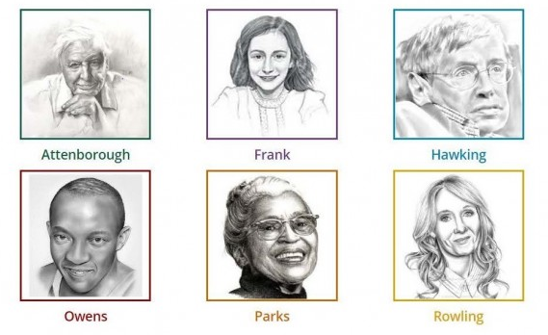
Our House System
….........................................................................................................................................

Slide 7
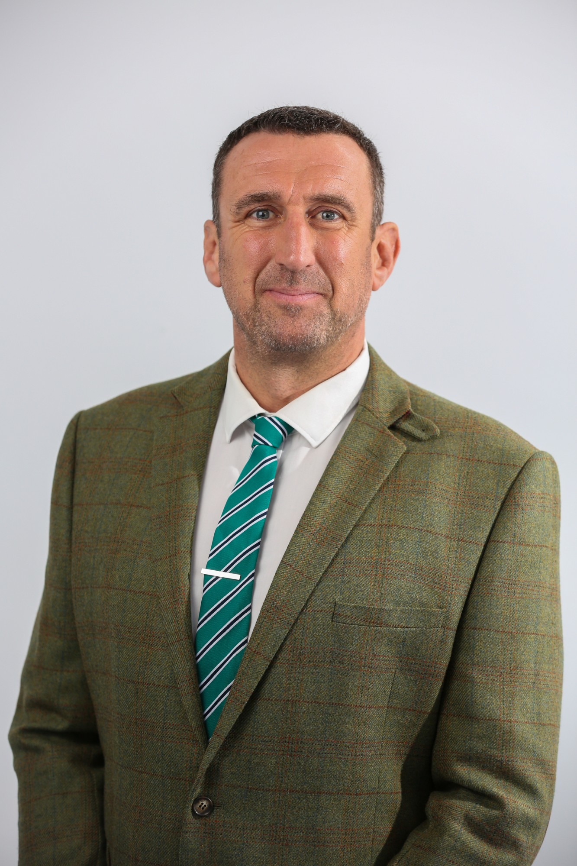
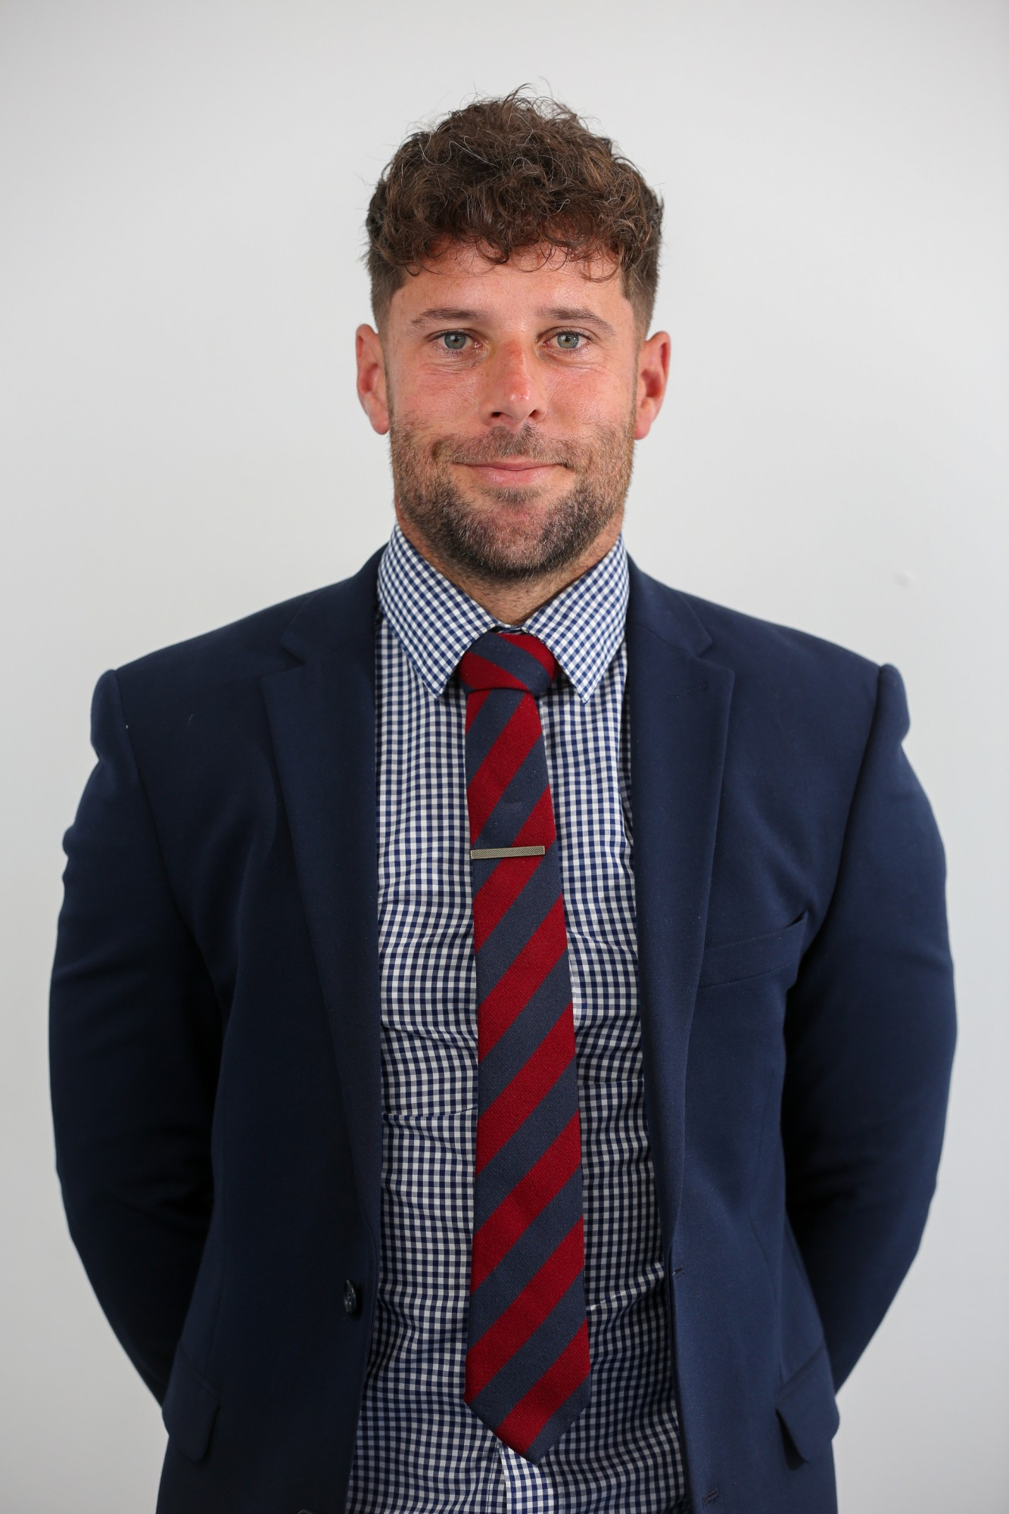
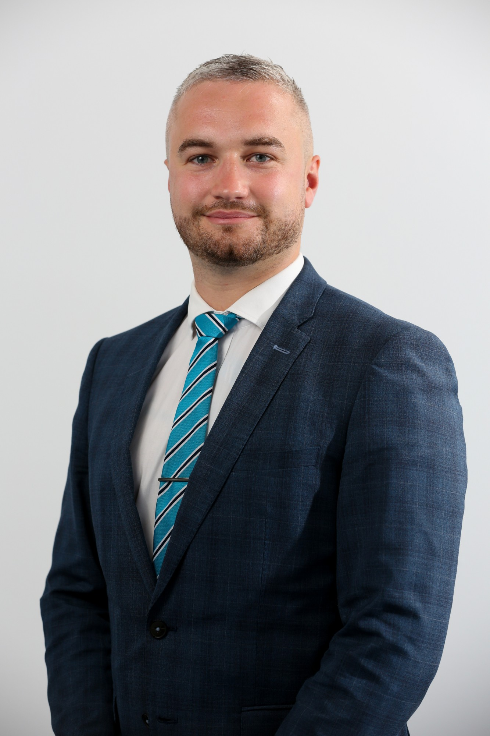
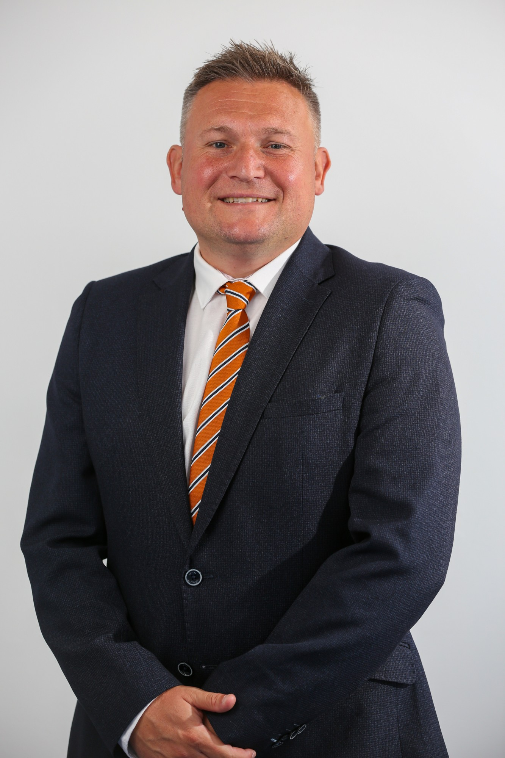
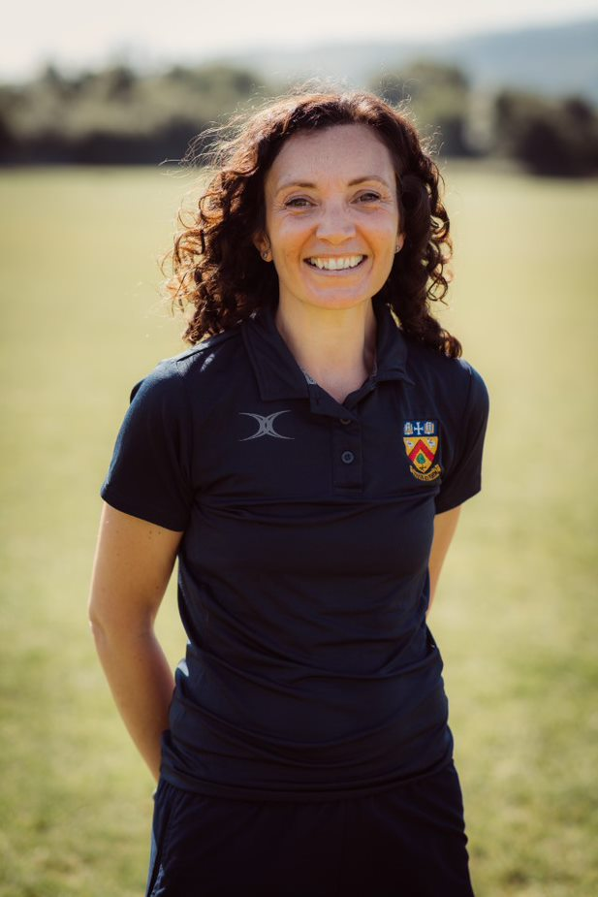
Heads of House
Attenborough
Frank
Hawking
Owens
Parks
Rowling
Mr Bashford
Mr Crowford
Mr Freeman
Miss Kelly
Mr Hirons
Mrs Stickland

Slide 8
Attendance is the key!

Slide 9
Welfare
Mrs Groves, Assistant Headteacher

Slide 10
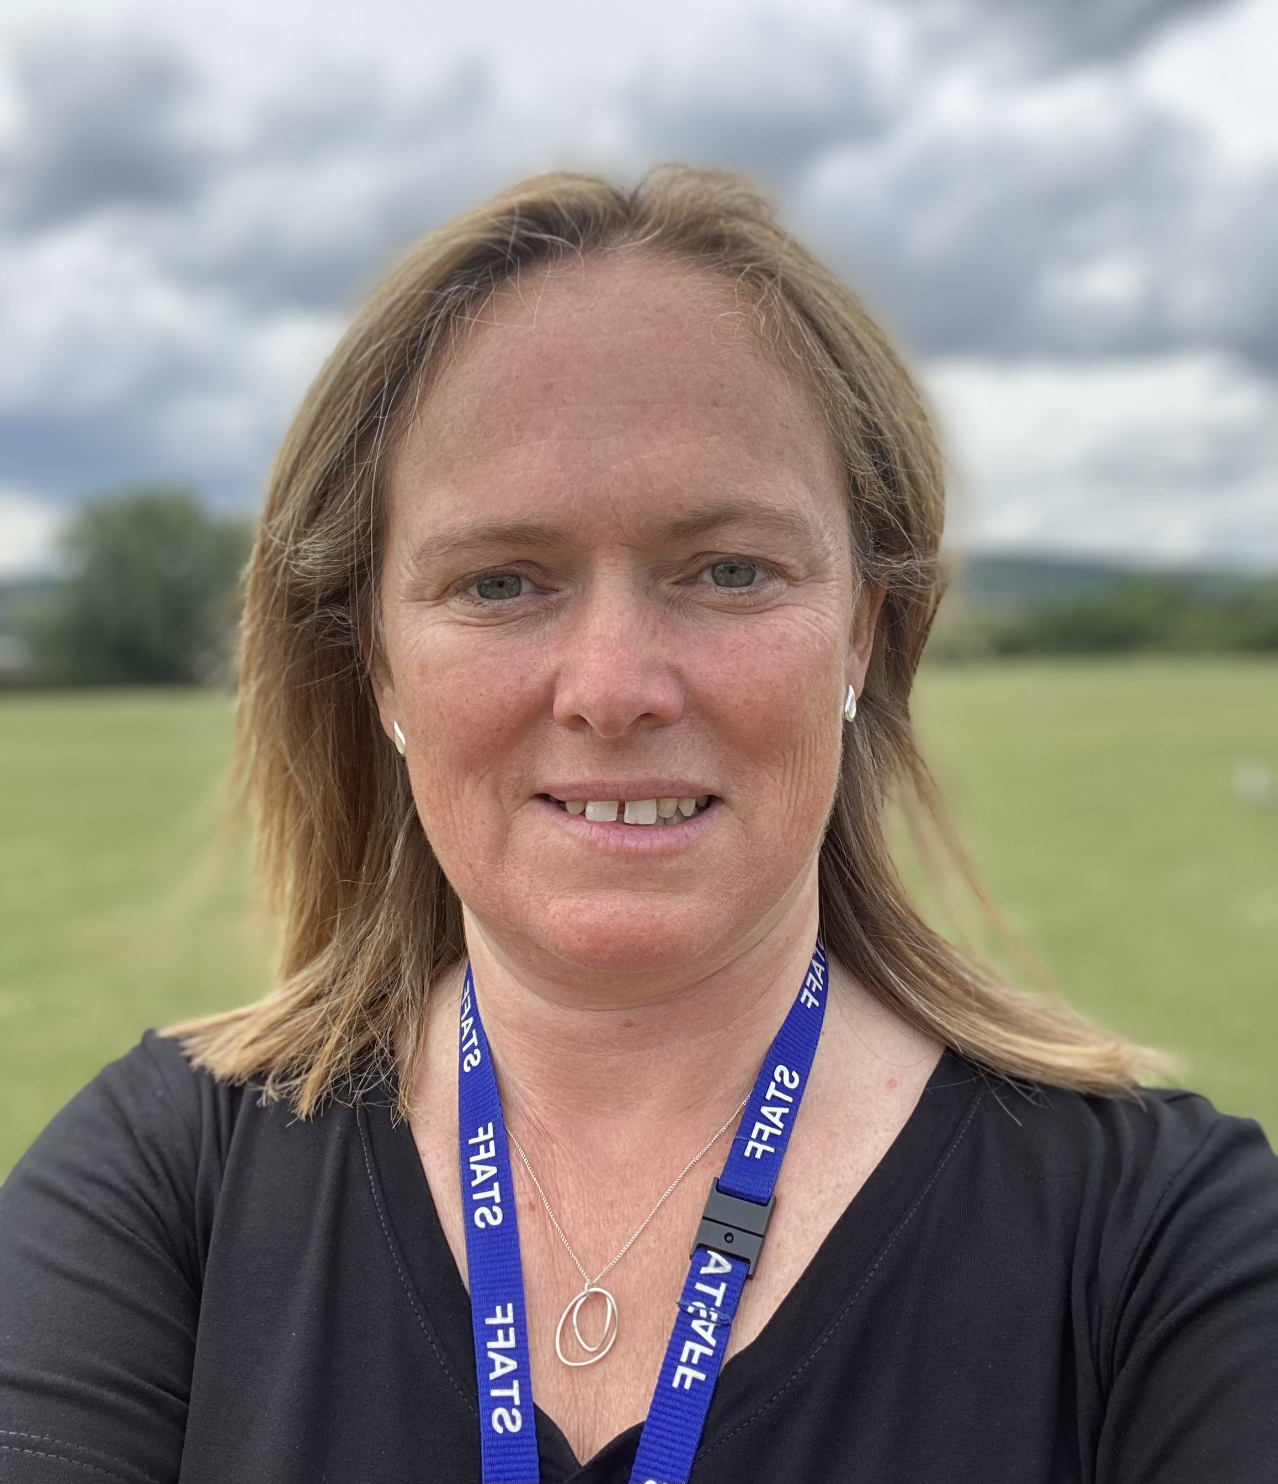
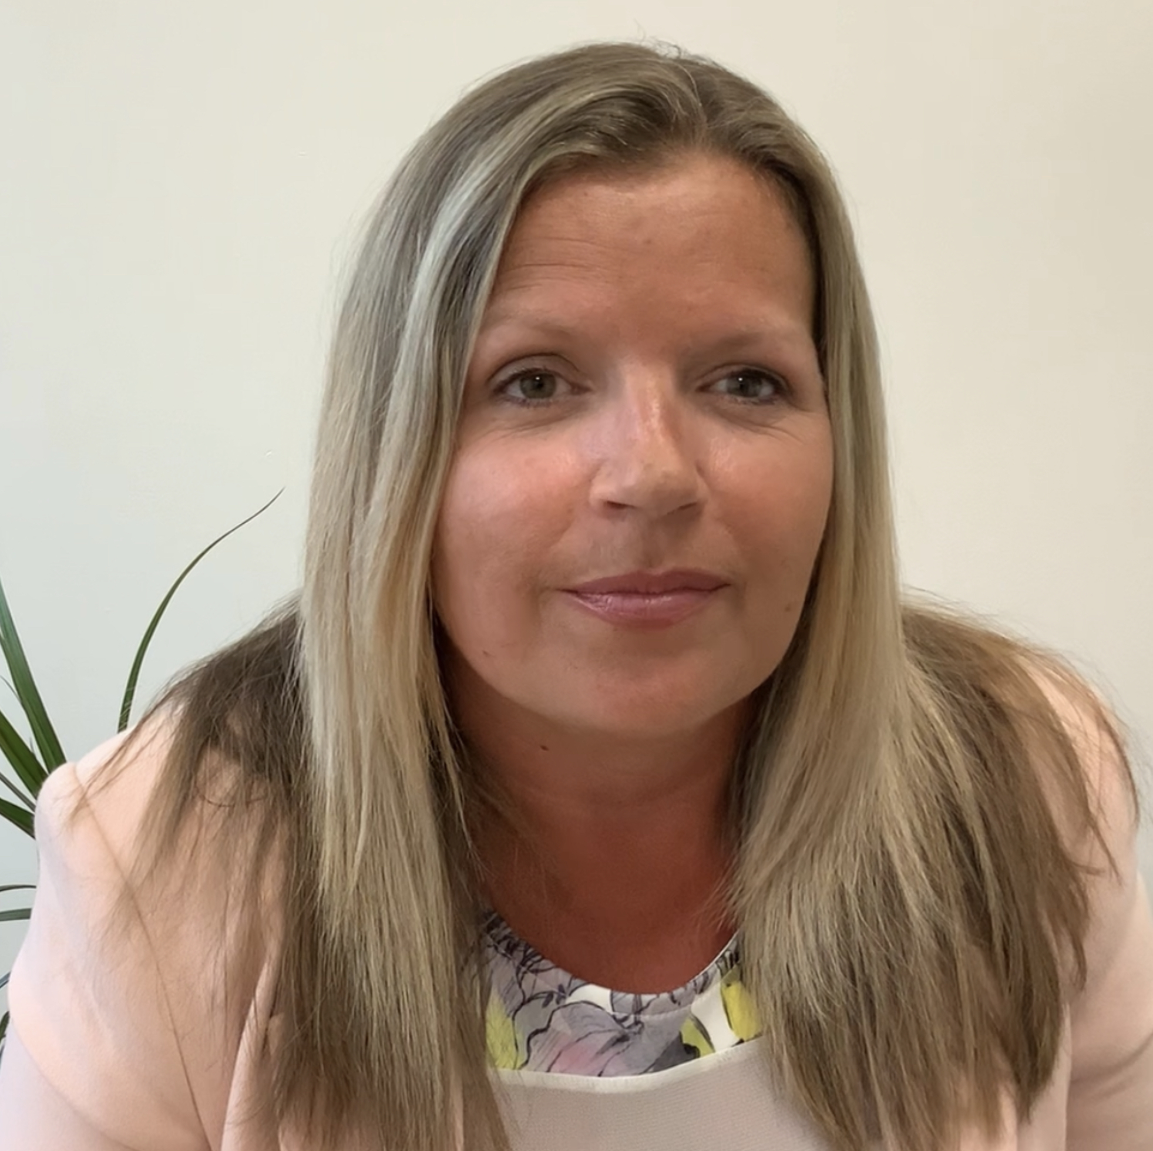
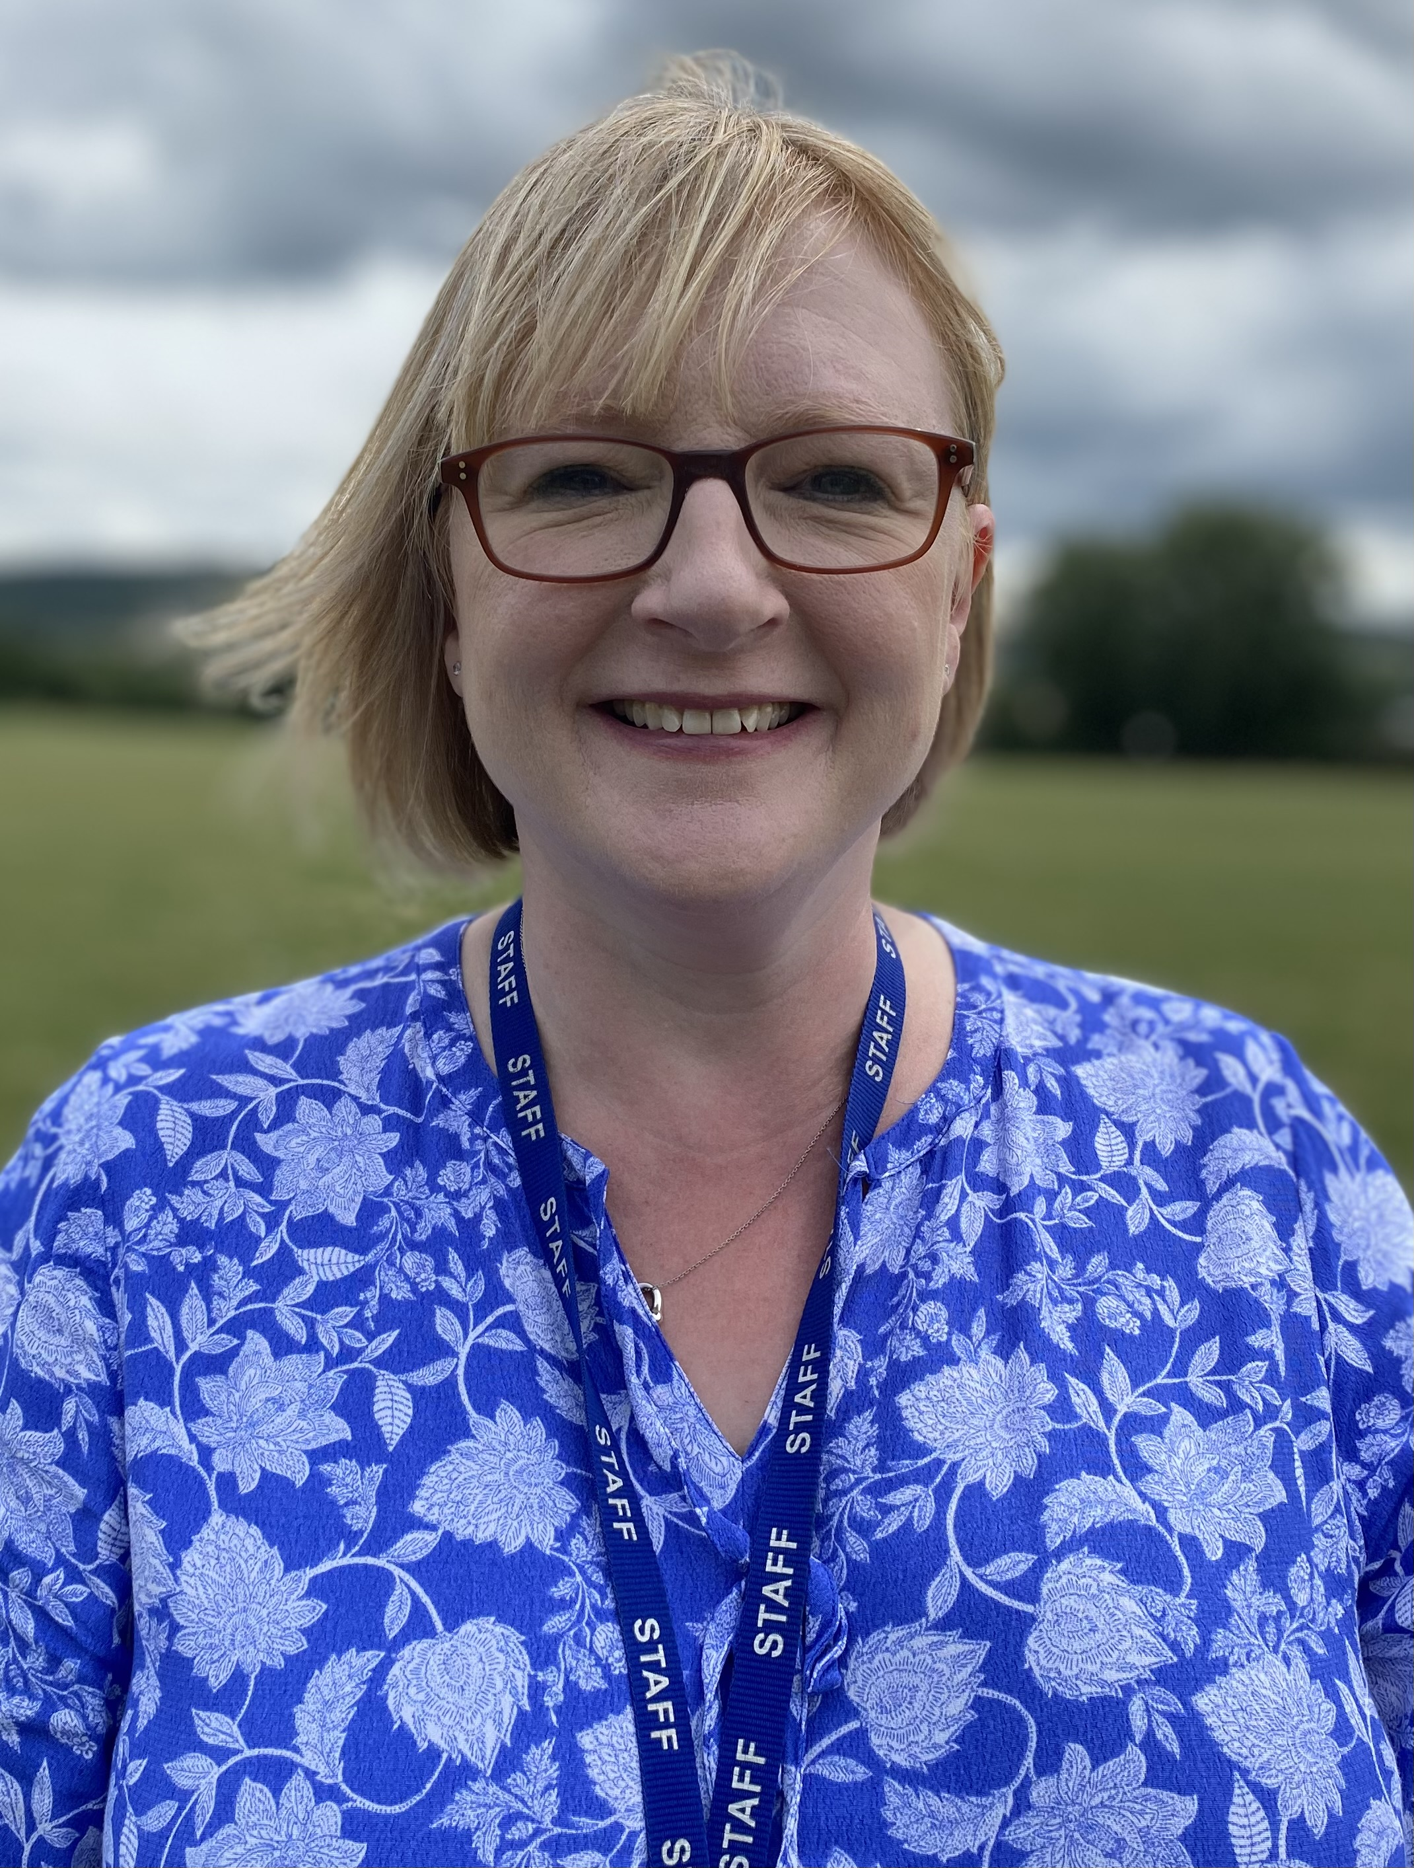
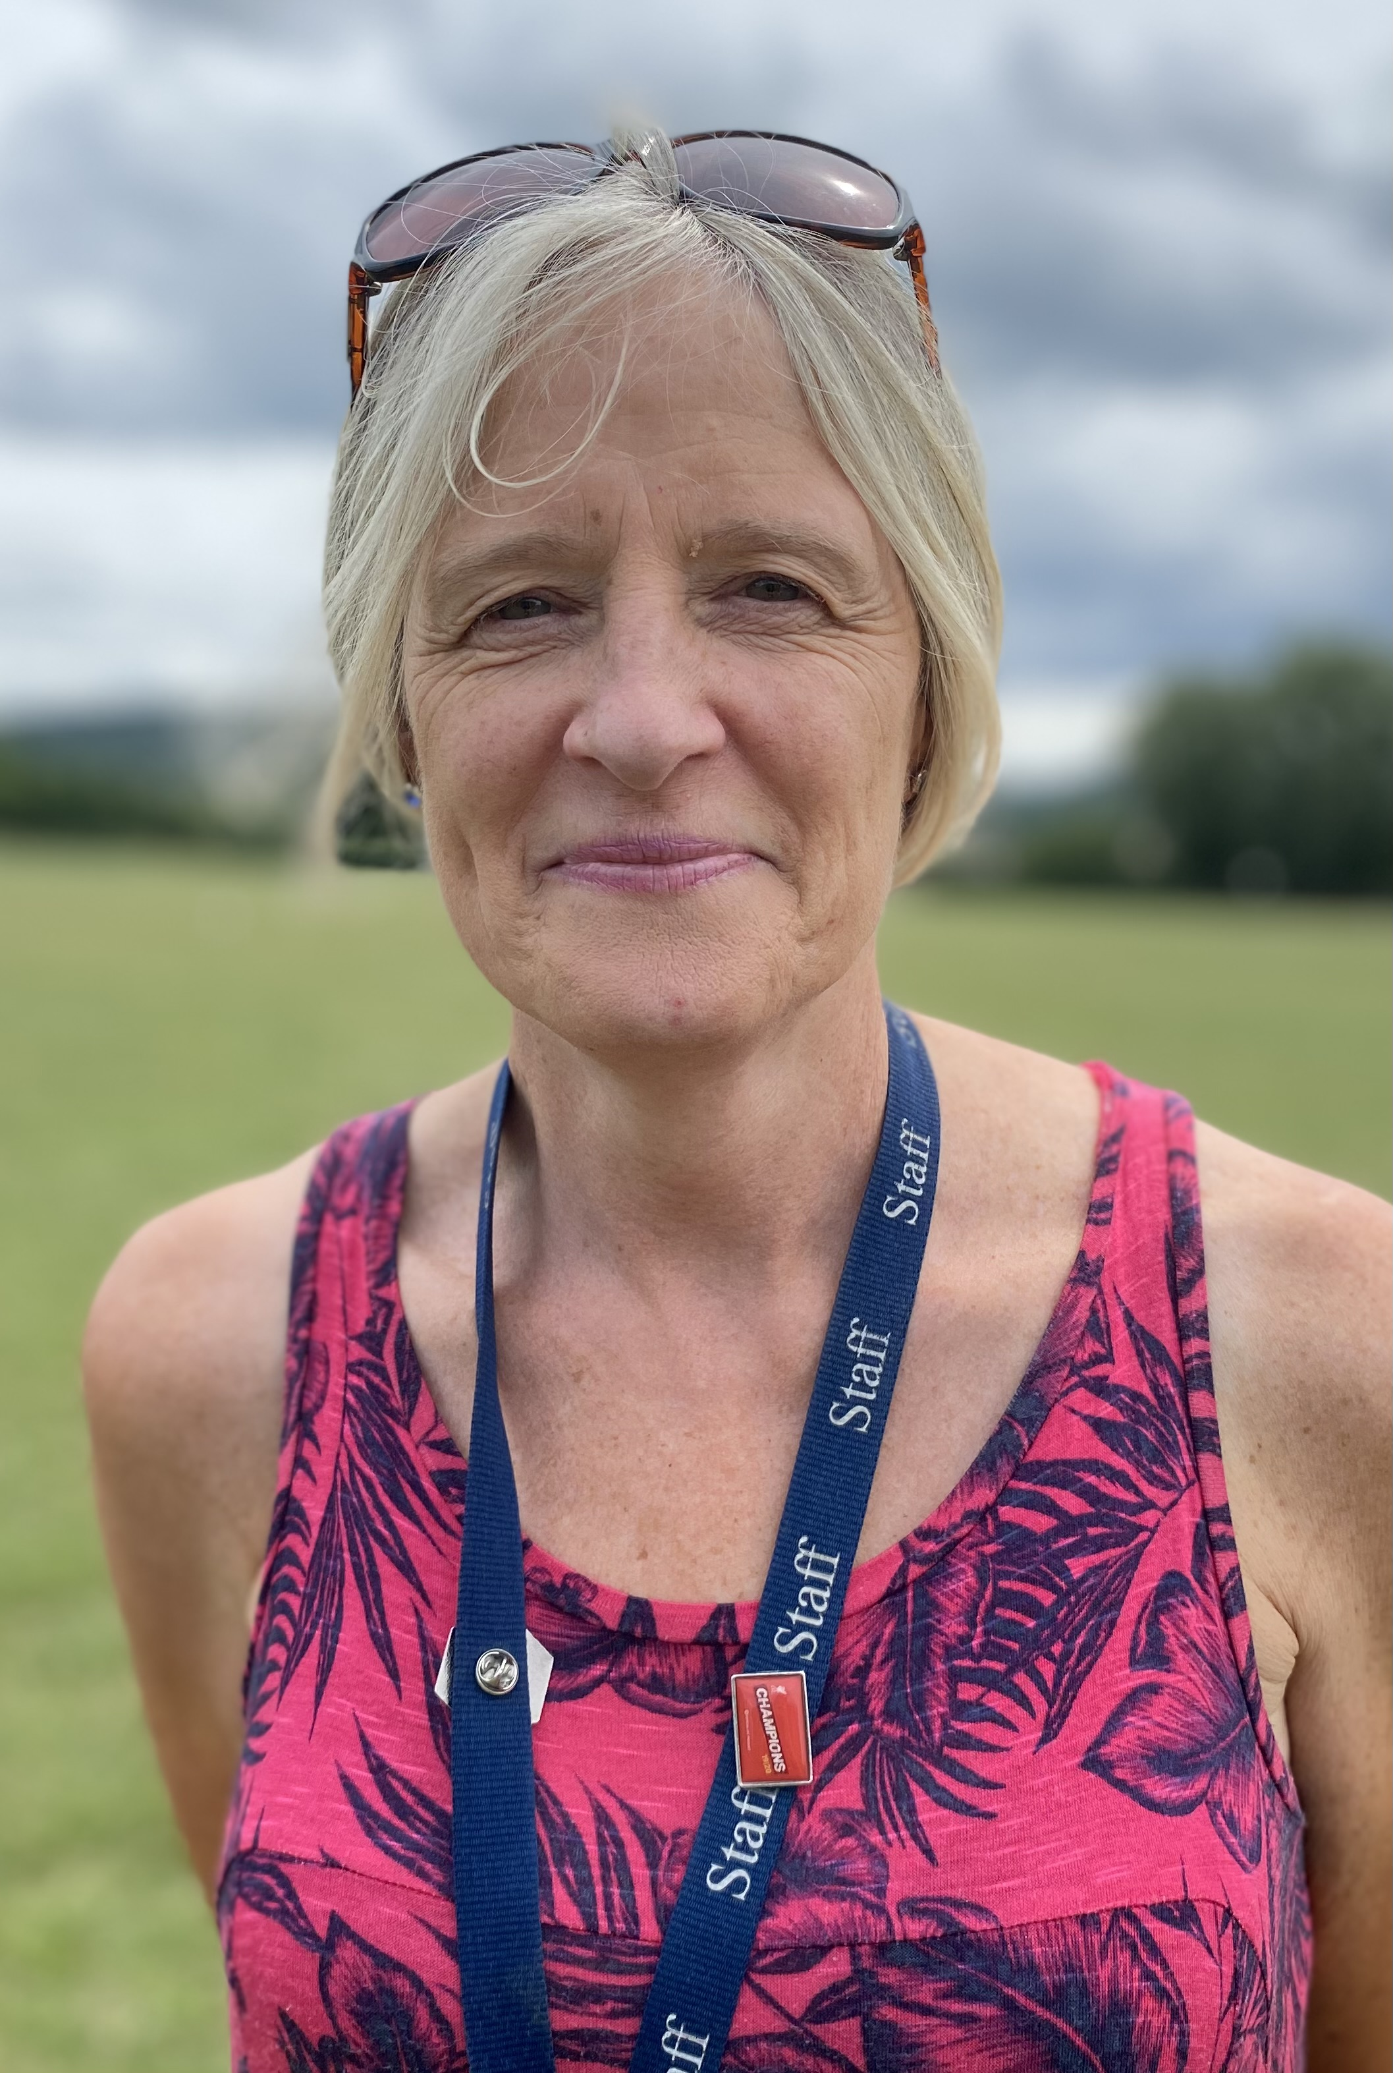
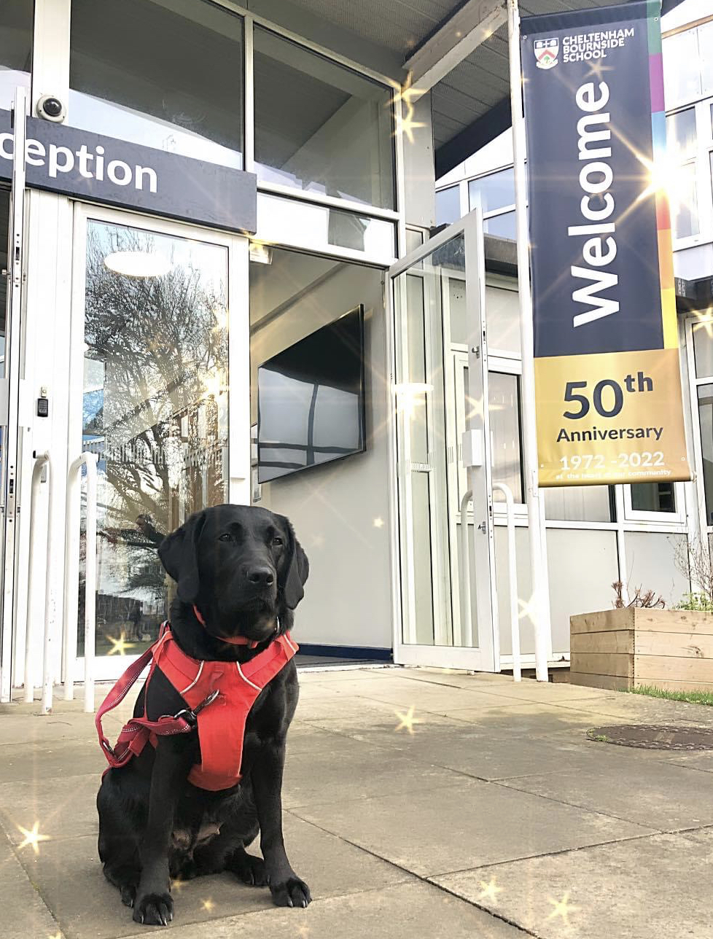
House Welfare Team
Assistant Head/ DSL
Frank & Rowling
Attenborough & Owens
School Welfare Dog
Hawking & Parks
Mrs Groves
Mrs Davis
Mrs Cubbins
Mrs Lloyd
Lottie

Slide 11
Induction Week
Mrs Groves, Assistant Headteacher

Slide 12
Induction Week
Monday 3rd – Friday 7th July 2023
Start time 8.45am
Finish time 3.10pm, except Friday 2:45pm
Wear their primary school uniform
except on Wednesday when they will need to be in their primary school PE kit
Friendships
Encourage them to say hello and make new friends
….........................................................................................................................................

Slide 13
What to bring
Rucksack
Snacks, water bottle, packed lunch, pencil case
Please make sure things are named!
Wednesday - wear primary school PE kit and trainers for a sports afternoon
….........................................................................................................................................

Slide 14
Activities on Monday
Welcome year group assembly
Team building
Orientation around the school
House assembly
House photos
Introduction to a 'growth mindset' approach to life
Lessons
Meet the tutor
Parents welcome to come into school at 3.10pm to meet their child's tutor. They will be dismissed from their House gate and we welcome you to come in and meet their tutor via the House gate. Finish at 3:45pm.
….........................................................................................................................................

Slide 15
Activities on Tuesday
Lessons including.... Music, Maths, English, Science, Modern Foreign Languages, Drama, Dragon's Den – Business GCSE challenge, Computing, RS, History, Geography, Design Technology
….........................................................................................................................................

Slide 16
Activities on Wednesday
WEAR THEIR PRIMARY SCHOOL PE KIT
Lesson experiences
Learning and Culture at Cheltenham Bournside School
Meeting Mr Penny and Mr Waters, Deputy Headteachers
Sports experience – afternoon session – PLEASE can they wear trainers this day
….........................................................................................................................................

Slide 17
Activities on Thursday
Lesson experiences
Clubs Fair
Ambition: all pupils choose at least one
club they would like to do in the first big term
….........................................................................................................................................

Slide 18
Activities on Friday
Musical experience
Starting a new legacy
House songs and 'the class of 2028' year group song
Welcome parents to come and listen to our 'concert in a day'
On the field
Bring a picnic blanket!
1.45pm on Friday 7th July
Entry via car park gates
Finish at 2:45pm
….........................................................................................................................................

Slide 19
Our School Day – KS3 version

Slide 20
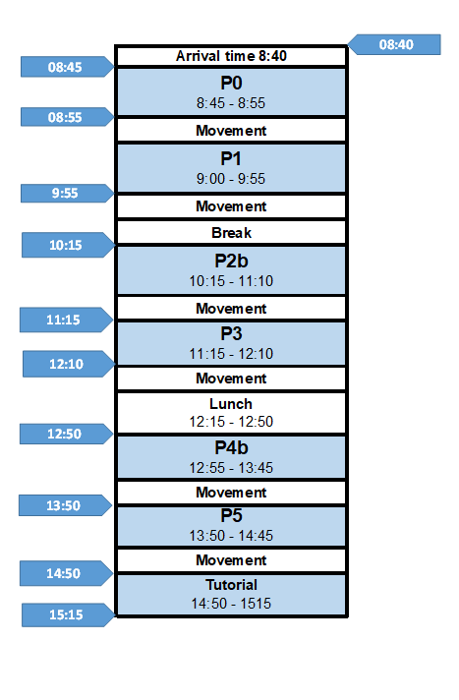

Slide 21
Coffee Mornings
Thursday 29th June 10.15 - 11.30am
(Attenborough, Frank, Hawking)2
Friday 30th June 10.15 – 11.30am
(Owens, Parks, Rowling)
Email: transition@bournside.gloucs.sch.uk

Slide 22
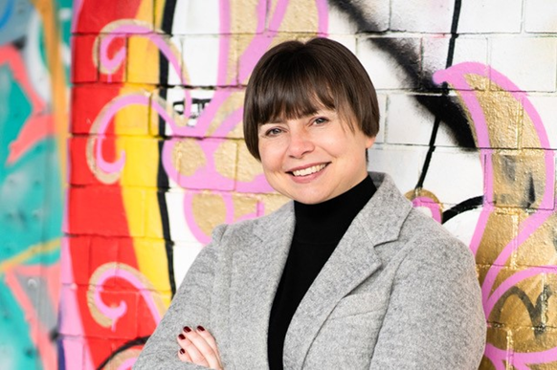
'How to Grow a Grown Up: parenting tips for the 21st century’ with Dr Dominique Thompson
Thursday 6th July, 6.00pm
Join award winning GP and author Dr Dominique Thompson in the Main School Hall for an enlightening and entertaining parent talk with Q&A about raising teens to thrive in the modern world, and living with a teenager! Full details have been shared in a separate letter.
The event is free of charge but tickets must be reserved by completing this Microsoft Form.

Slide 23
Staying safe online

Slide 24
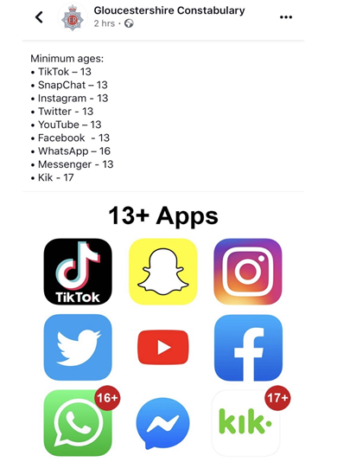
Social media
They need your support
Check their phones regularly
Who are they talking to?
What APPS are they using?
Off before bedtime and charging overnight downstairs
….........................................................................................................................................

Slide 25
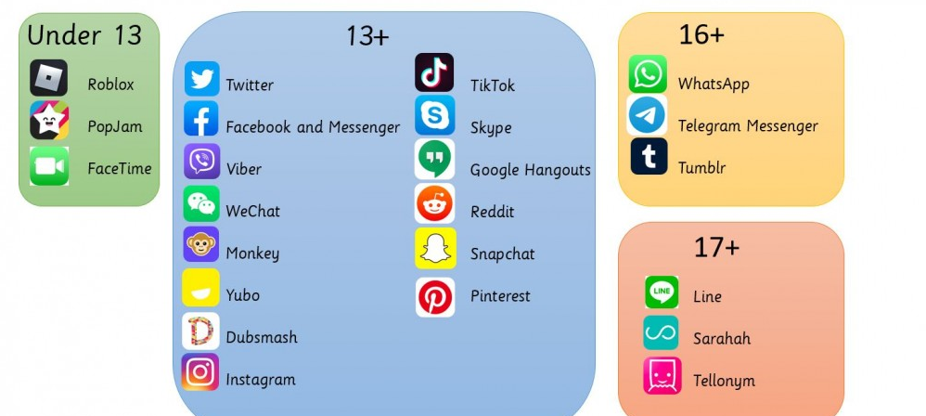
Social media
You pay the bill. It's your phone and therefore your responsibility!

Slide 26
National Online Safety
FREE app
Easiest way to keep children safe online
Covers the latest apps, games and devices used by children
Provides instant access to online safety education, training and updates so that parents can protect their children from online harm and abuse.
They release updated parent guides to all forms of social media and apps which will enable you to safeguard your son / daughter whilst they are online.
FREE AGE-SPECIFIC PARENTS ONLINE SAFETY COURSES
….........................................................................................................................................

Slide 27
National Online Safety
FREE access to the ‘Online Safety for Parents’ video course, hosted by mum of 3 and online safety ambassador, Myleene Klass.
A new guide every week as part of our #WakeUpWednesday campaign.
• Find out about the latest online platform, game or device children are talking about.
• Search for online risks and get tips for keeping children safe online.
• Learn about parental controls and how to monitor online activity.
• Share, review and download your favourite guides.
….........................................................................................................................................

Slide 28
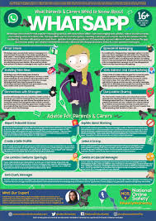

Slide 29
Our teams and external professionals who support your children
Sharon Haines, EAL Co-ordinator
Nicola Berry, Admissions
Rob Mudge, SENCo
Yeing-Sonn Chong, Young Minds Matter Gloucestershire NHS
Natalie Strong, School Nurse, Gloucestershire NHS
Heads of House and our House Welfare team
Monkhouse Uniform suppliers

Slide 30
Terms starts on
Wednesday 6th September 2023

Slide 31
Empowering lives through learning

